Slide 1
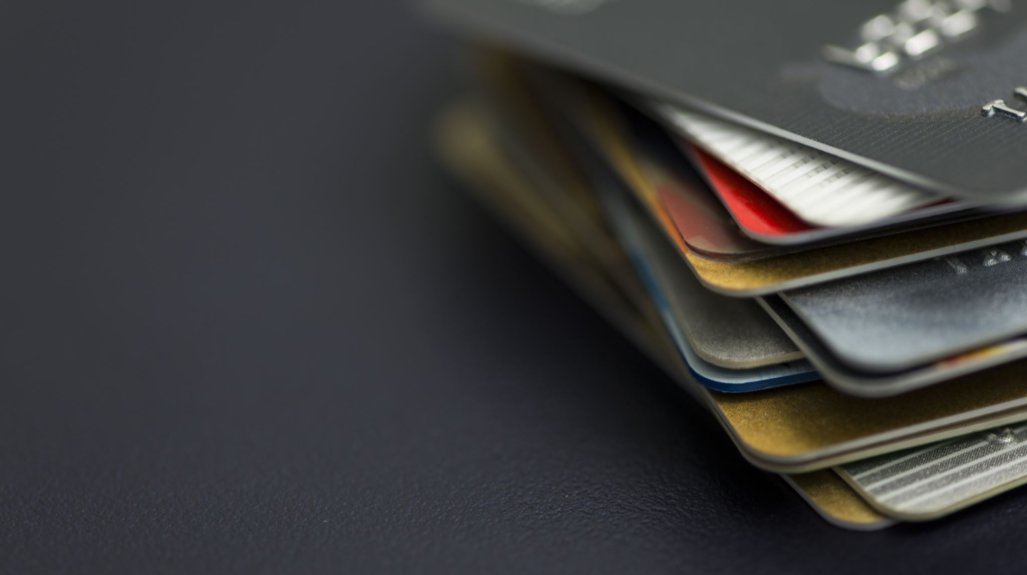

Financial Fraud Prediction
IST 707 Group Presentation
Remp | Forkert | Haase
Notes:
Slide: Title
Presenter: All
Time:
We ended at 12:16

Slide 2
Introduction
The Threat of Fraud in Banking: Fraudulent transactions lead to financial losses, inefficiencies, and diminished consumer trust, impacting individuals, businesses, and the broader economy.
Consumer and Business Impact: Customers risk compromised personal and financial data, while businesses face increased costs from chargebacks, lost inventory, and heightened security protocols.
Stricter Security Measures: Persistent fraud results in more stringent and potentially inconvenient banking security processes for everyone.
Advancing Fraud Detection with ML/AI: The banking industry is adopting machine learning (ML) and artificial intelligence (AI) technologies to enhance fraud detection and prevention systems.
Notes:
Slide: Introduction
Presenter: Justin
Time:1:38, 1:05
Fraudulent transactions cause huge financial looses to buinesses, exposure of customers’ personal data, damage in consumer trust and a strain on the broader economy. In response, Stronger security measures have been put in place. However, these can interrupt the intentional convenience of the banking services. To have security with minimal disruptions, the banking industry is increasingly turning to machine learning and AI solutions. In this project, we sought out to improve upon the Machine Learning Models, which brings us to our dataset.

Slide 3

Data
Source:
Kaggle PaySim1 Dataset
Content:
1M synthetic financial transactions with 11 features (e.g., amount, location, type)
Purpose:
Fraud detection research using simulated real-world financial data
Origins:
Created via PaySim, funded by Sweden’s Knowledge Foundation (Grant: 20140032)
Advantages: Designed to mimic real-world scenarios. Widely used in academic fraud detection studies.
Notes:
Slide: Data
Presenter: Justin
Time: 1:10, :40
We choose a synthetic dataset from Kaggle to avoid the encrypted attributes of a real world, public dataset and therefore mimic the data access of ML developers in the industry. This is a mildly large dataset containing 1M synthetic transactions with 11 features. Data was developed by PaySim, funded by Sweden’s Knowledge and has been widely used in academic studies.

Slide 4
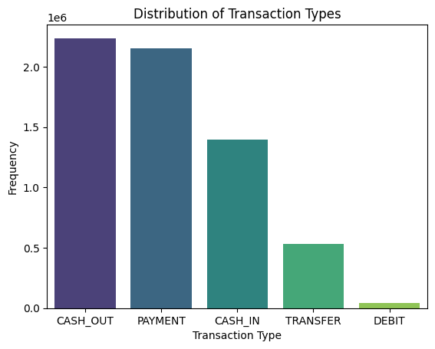
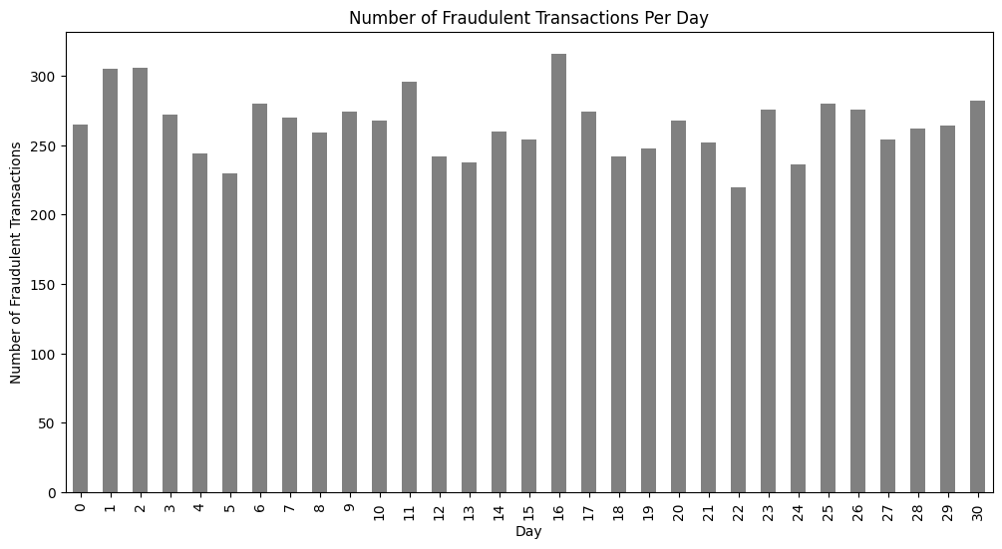
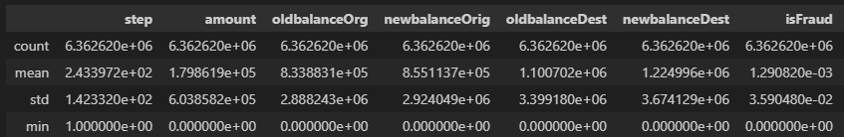
Data Breakdown
Summary Statistics
Notes:
Slide: Data
Presenter: Justin
Time:2:11, 1:04
As you see on the top left, we have several types of transactions. Below are some descriptive statistics of some of the features in our data. The step,an increment of time, the old balance Original, the new balance. Fraud is a binary column, which approaches mean approaches zero, which implies most transactions are not fraud.

Slide 5
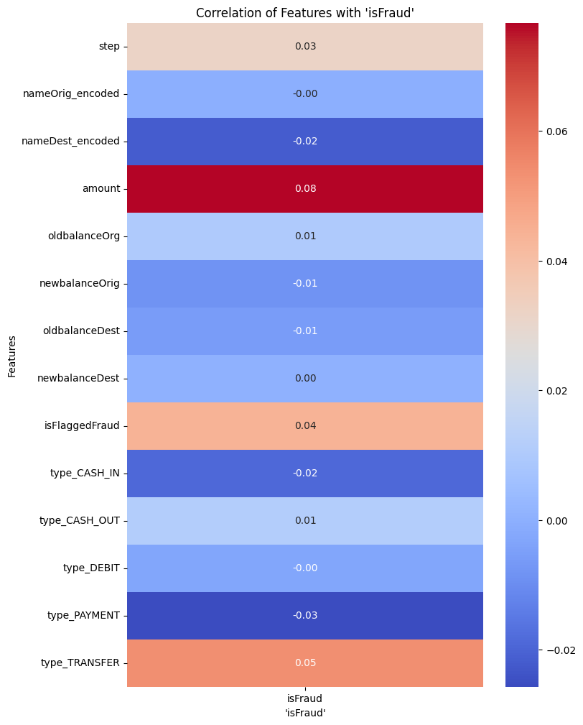
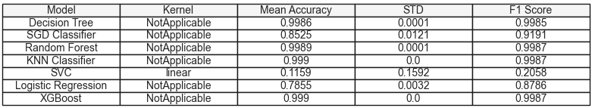
Methods
Determine x variables we want to keep
Run multiple models against the data to find the best performing model
Train and test against the best performing model
Notes:
Slide: Methods
Presenter: Samuel
Time: 1:15

Slide 6
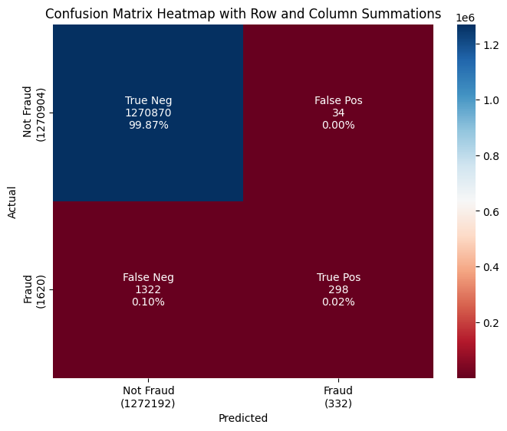
results
In the table to the right you can see that there are 298 incidents where the prediction aligned with the actual Fraud.
There are 34 cases of predicted Fraud that ended up being not Fraud.
There are 1322 cases of Fraud that the model predicted as not Fraud.
The benefit of using this method is capturing 298 cases real time versus after post analysis. With model refinement the bias toward false positives can reduce the number of false negatives.
Notes:
Slide: Results
Presenter: Samuel
Time: 2:20, 1:

Slide 7


Discussion
Successes
Opportunities
Provided better results that solely flagging transactions above $200,000. This would provide a higher success rate for flagging fraud.
Adds flagging transactions that are not fraud as fraud. This could add additional customer frustration.
Notes:
Slide: Discussion
Presenter: Erika
Time: .5 min
48 sec, “37

Slide 8
Limitations and Future Work
Monitor Accuracy
Bias
Synthetic Data
Supervised Methods
Limited Data Features, may not get the same data in a real-world setting
Analysis could benefit from different methods and additional columns including locations, customers, and transaction history.
The ability to track emerging fraud trends or patterns based on new data may help the model maintain or improve accuracy levels.
Fraud flagging should be reviewed to see if the model imposes bias with flagging.
Notes:
Slide: Future work
Presenter: Erika
Time: .5 min
1:30, 1:09

Slide 9
Questions?
Thank you
IST 707 Group Presentation
Remp | Forkert | Haase
Notes:
Slide: Title
Presenter: All
Time:
We ended at 12:16

